Slide 1


Slide 2

DEV316 ---
Advanced ASP.NET Web Services
Rob Howard
Program Manager
.NET Framework Team
Microsoft Corporation
Field Reviewer: cbrawley

Slide 3

Agenda
Prerequisite:
  Introducing Web Services talk (DEV206)
  Familiarity with ASP.NET Web Services
  Understanding of SOAP and WSDL
Beyond the [WebMethod] attribute
  Screen Scraping, XML Wire format
  Soap Header, Security
  Soap Extensions

Slide 4
Screen Scraping

Slide 5
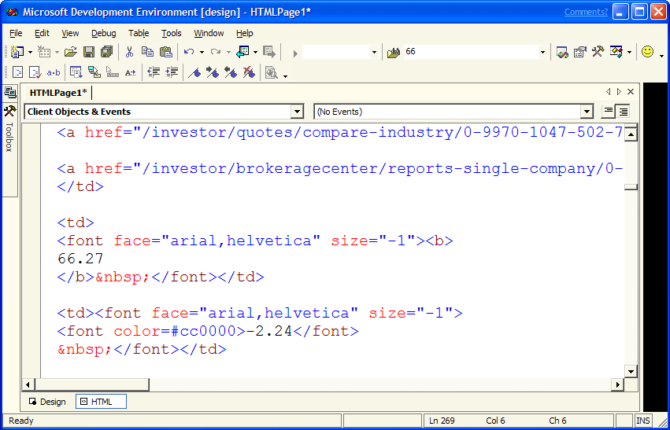
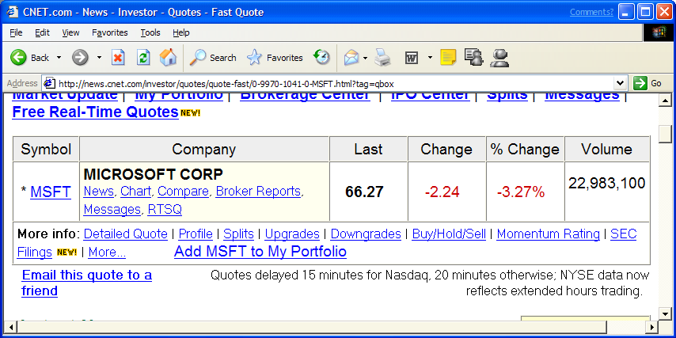

Slide 6
Screen Scraping
Web site into a Web Service*
  Scenario: existing logic and data
  No HTML or HTTP knowledge required
Custom WSDL extensions
  Describe match with RegEx
  Tools create object oriented proxy class
Features
  Supports arguments, e.g. ?isbn=12345
  Multiple captures per request

Slide 7

CNET

Slide 8
XML Wire Format

Slide 9
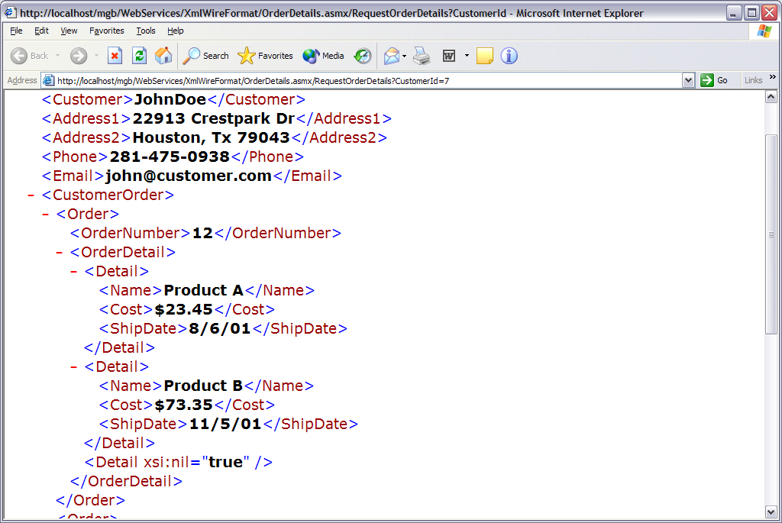

Slide 10
XML Wire Format
Granular control over XML format
  HTTP-GET and HTTP-POST
  SOAP
  Described in WSDL
Attributes for the XML Serializer
  System.Web.XmlSerialization
  XmlElement | SoapElement
  XmlAttribute | SoapAttribute
  XmlArray | SoapArray

Slide 11
Order Details

Slide 12
SOAP Headers

Slide 13
SOAP Message
SOAP Headers
SOAP Body

Slide 14
SOAP Headers
Support for out of band data
  Similar to HTTP Headers
  Direction control
Simple API
  Inherit from SoapHeader
  Use SoapHeaderAttribute
Represented in WSDL
  Describes SOAP Header
  Proxy generation is automatic

Slide 15
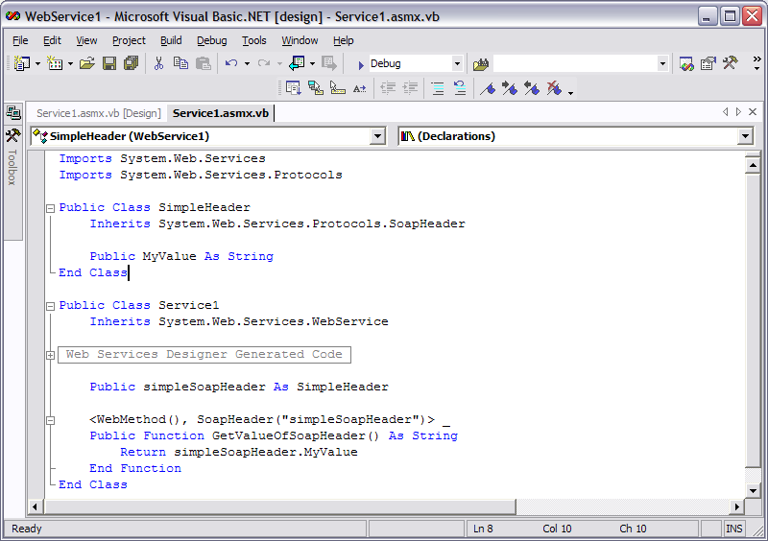
SOAP Headers

Slide 16
Authentication

Slide 17
SOAP over HTTP Request
Consumer
HTTP
Server
HTTP Headers
HTTP
SOAP Headers
Authentication is part of the protocol, either HTTP or SOAP
SOAP Message
HTTP Body
SOAP Body

Slide 18
Authentication
Assign identity to a request
  What permissions does the caller have
  What is the identity allowed/denied
  Not defined by SOAP specification
ASP.NET Authentication Options
  Windows
  Passport / Html Forms (HTTP Cookie)
  Custom, i.e. roll your own

Slide 19
Custom Authentication
SOAP is transport independent
  Authentication uses HTTP Headers
  Decouple from transport protocol
SOAP Headers
  Part of SOAP message
  Credentials are transport independent
Integrates with ASP.NET easily
  Application events
  ASP.NET User intrinsic

Slide 20
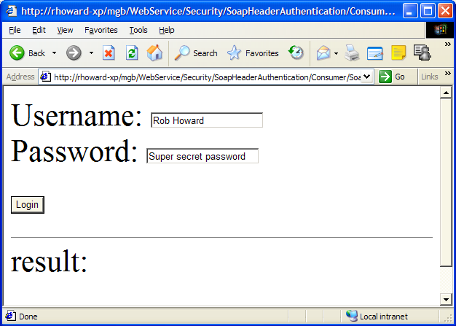
Custom Authentication

Slide 21
Soap Extensions

Slide 22

Serialization
Class/Type
Serializer
XML
*
*
SOAP
Deserialization
XML
Serializer
Class/Type
*
*

Slide 23
SoapExtension Class
Soap Extension
  Low-level interaction
  Custom attribute
  Serialization message stages
  Deserialization message stages
Message Stages
  SoapMessage.BeforeSerialize
  SoapMessage.AfterSerialize
  SoapMessage.BeforeDeserialize
  SoapMessage.AfterDeserialize

Slide 24
Simple Extension: Tracing

Slide 25
Encrypt SOAP Messages
Encrypt Soap Message
  Server: BeforeSerialize
  Consumer: BeforeDeserialize
Similar to header authentication
  Transport independent
  Route valid SOAP messages
Derive SoapExtension class
  EncyrptionExtension attribute
  No knowledge of encryption required

Slide 26
Encrypting SOAP

Slide 27
Best Practices
Don’t use properties as WebMethods
  Properties imply state
Session state implications
  Requires client to manage cookies
Use Caching features
  CacheDuration property
Web Services aren’t for everything
  Distributed Internet applications

Slide 28
Summary
Customers win
  ASP.NET Web Service are easy
  Customers already have the skills
Advanced Web Services
  Lot’s of features beyond WebMethod
  Screen Scraping, Headers, etc.
Soap Extensions
  Plumbing functionality is available
  Tons of custom solutions

Slide 29
Resources
Community
  ASP.NET Discussion lists
  http://www.asp.net
Books
  Professional ASP.NET
  Web Services books due soon

Slide 30


